Slide 1
Lecture 11
Dr. Lauren Chenarides
November 6, 2025

Slide 2
Without continual growth and progress, such words as improvement, achievement, and success have no meaning. -Benjamin Franklin (founding father of the United States)

Slide 3

Lecture 11: Growth, Scaling, & Venture Valuation in Agribusiness and Food Ventures
Textbook Reading (Quiz Basis)
Chapter 13. Strategic Entrepreneurial Growth: Scaling
Chapter 14. Valuation of Entrepreneurial Ventures
Lecture Agenda
1.
2.

Slide 4
Chapter 13 Objectives
13.1 Discuss the importance of strategic planning with emerging firms.
13.2 Describe the nature of strategic planning.
13.3 Outline the challenges of managing entrepreneurial growth.
13.4 Explain the transition from an entrepreneurial to managerial approach.
13.5 Identify the key factors that play a major role during the growth stage.
13.6 Discuss the complex management of paradox and contradiction.
13.7 List the steps useful for breaking through the growth wall.
13.8 Explain the factors involved in growth hacking.
13.9 Identify the challenges involved with “blitzscaling.”
13.10 Explore the elements of building an entrepreneurial company.
13.11 Identify the unique managerial concerns with growth businesses.

Slide 5
Chapter 14 Objectives
14.1 Explain the importance of valuation.
14.2 Outline the underlying issues involved in the acquisition process.
14.3 Describe the basic elements of due diligence.
14.4 Outline the various aspects of analyzing a business.
14.5 List the major points to consider when establishing a firm’s value.
14.6 Highlight the available methods of valuing a venture.
14.7 Discuss the three principal methods currently used in business valuations.
14.8 Explain the additional factors that affect a venture’s valuation.

Slide 6
Lecture Content
By the end of this lecture, you should be able to:
Describe how agribusiness ventures move from growth to scaling and why planning becomes more important as they expand.
Use a SWOT analysis to identify what a business does well, where it struggles, and where new opportunities or risks exist.
Explain what scaling means and how to estimate market potential using TAM, SAM, and SOM.
Find and interpret real market data (for example, from IBISWorld) to understand a venture’s growth potential.
Explain how a business’s value is determined and why valuation matters for entrepreneurs and investors.
Calculate simple valuation examples and understand what EBITDA shows about a company’s financial performance.
Identify the main factors that drive value in agribusiness and food ventures, such as brand, customers, and profitability.

Slide 7
Phases of Venture Growth
Growth Phase
Scaling Phase
Venture Valuation Phase
Determining Product-Market Fit
Building systems to grow efficiently
Positioning for exit, sale, or strategic partnerships
Expanding market reach to drive valuation

Slide 8
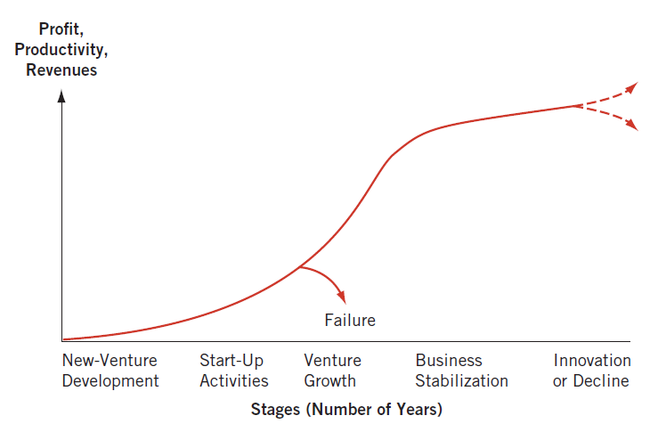
A Venture’s Typical Life Cycle

Slide 9
A Venture’s Typical Life Cycle
New-Venture Development and Start-Up Activities:
Activities associated with the initial formulation of the new venture’s general philosophy, mission, scope, and direction.
Creating a formal business plan, searching for capital, carrying out marketing activities, and developing the entrepreneurial team.
Focus: Test assumptions and find product-market fit

Slide 10
A Venture’s Typical Life Cycle
Once a venture achieves traction, it enters the Venture Growth stage.
Revenues start to rise rapidly.
Some ventures fail here because they grow faster than their systems, capital, or market can support.

Slide 11
A Venture’s Typical Life Cycle
Those that manage growth effectively move into Business Stabilization.
Systems, operations, and strategy become more formalized
Strategic planning and scaling decisions matter most here.

Slide 12
A Venture’s Typical Life Cycle
From there, ventures must continue to innovate to sustain performance, or risk decline as markets shift.

Slide 13
Part 1: Growth Phase

Slide 14
Phases of Venture Growth
Growth Phase
Scaling Phase
Venture Valuation Phase
Determining Product-Market Fit
Building systems to grow efficiently
Positioning for exit, sale, or strategic partnerships
Expanding market reach to drive valuation

Slide 15

Recall: “Fit” is what happens when the value map aligns with the customer profile
Product-Solution Fit
Product-Market Fit
You are actually creating customer value and getting traction
Product/Service | Satisfies | Customer job
Pain relievers | Alleviate | Pain points
Gain creators | Create | Additional value or benefits that your customers desire

Slide 16
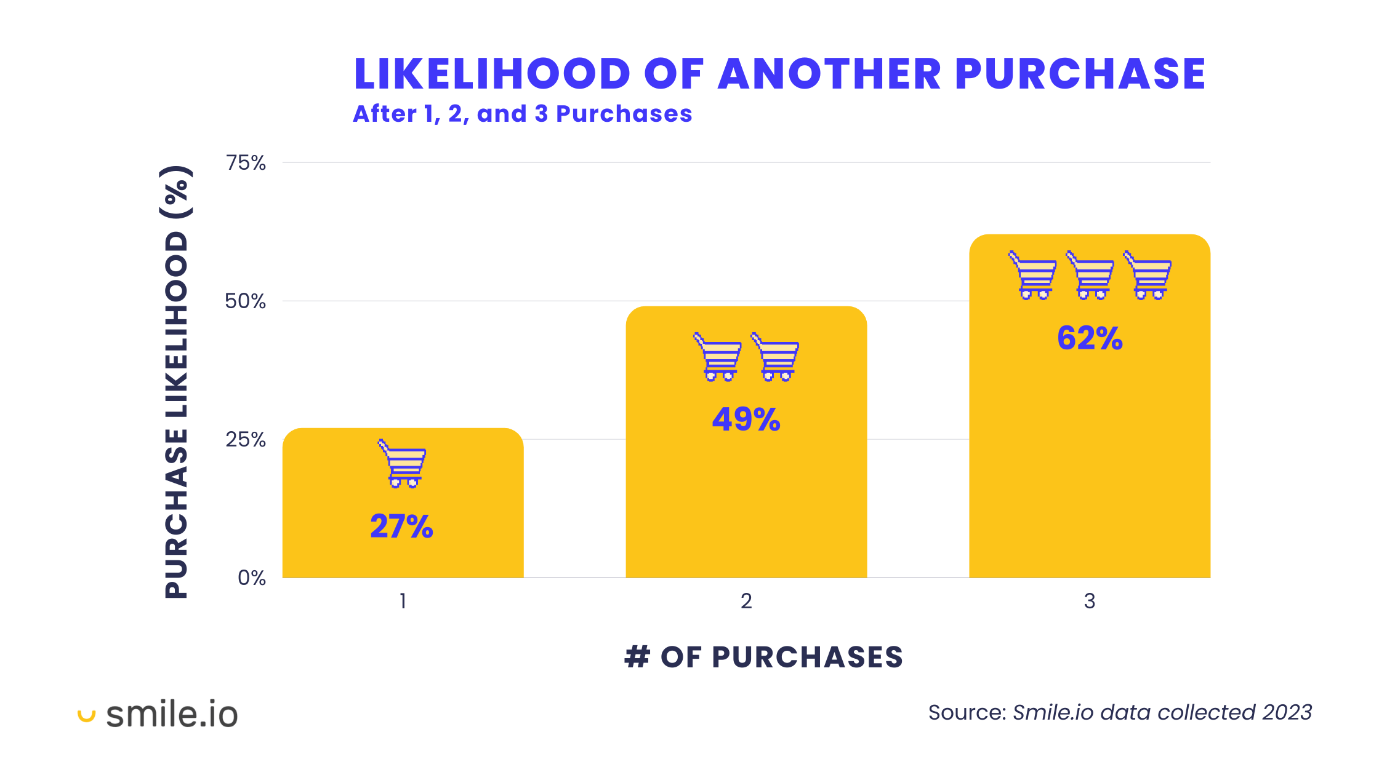
How do you know if you are creating value/getting traction?
Customers are repurchasing or referring others
You’re seeing consistent growth in sales or user base
Customer feedback validates the product’s value
Retention is improving while acquisition costs stabilize
You’re starting to attract investor or partner interest

Slide 17
Driving growth through strategic planning
The need for formal, systematic planning arises when:
Expansion adds complexity (more people, products, and markets)
Market uncertainty or competition increases
The venture lacks adequate experience, either technological or business

Slide 18
What is “Strategic Planning”?
Strategic planning = formulating long-range plans to manage opportunities and threats give your venture’s strengths and weaknesses.
Includes:
Defining the venture’s mission
Specifying achievable objectives
Developing strategies
Setting policy guidelines

Slide 19
Basic Steps in Strategic Planning
Examine the internal and external environments of the venture (SWOT—strengths, weaknesses, opportunities, threats), SWOT analysis.
Formulate long-range and short-range strategies (mission, objectives, strategies, policies).
Implement the strategic plan (programs, budgets, procedures).
Evaluate the performance of the strategy and gather feedback for continuous improvement.

Slide 20
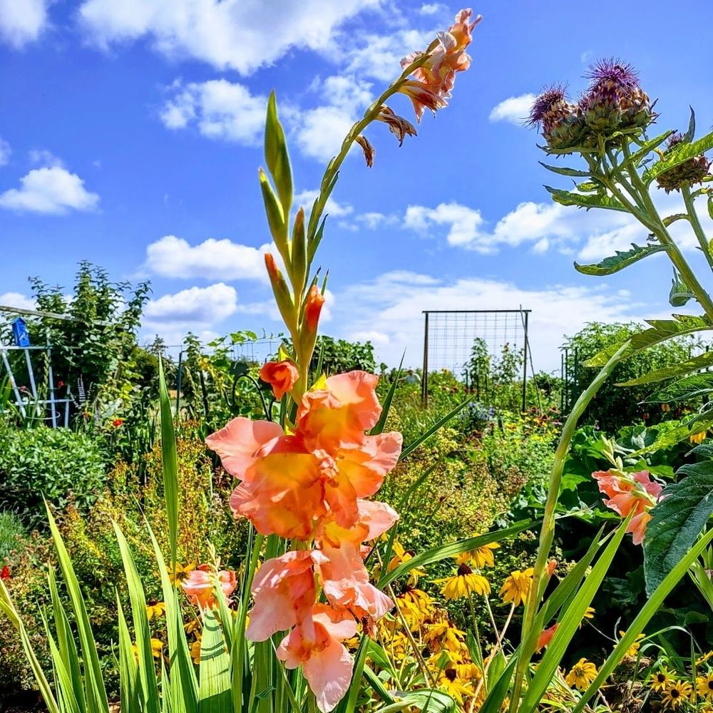
Example: Oregon Flower Farms
Oregon Flower Farm produces and sells locally grown cut flowers, herbs, dry-farmed produce, and pastured meats. They offer on-farm experiences such as U-picks, farm tours, and small private events.
Their business combines sustainable agricultural practices with agritourism to diversify income and connect directly with local consumers.
Value proposition: Oregon Flower Farms…
Helps | Local consumers, florists, and event organizers
Who | Want fresh, sustainably grown flowers and farm products
By providing | High-quality, locally sourced blooms and authentic farm experiences
That | Celebrate community, sustainability, and connection to place.

Slide 21
SWOT Analysis: Oregon Flower Farm
Strengths | Weaknesses
- Education & Experience - Own land & existing infrastructure/materials - Location – busy road, in between two good size urban areas - Construction and electrical skills - Amazing view! - Southeast exposure and good soil - Access to animal manure for amendment | - Limited to irrigating only ½ acre from well - Seasonal creek but no water rights - No capacity to farm full-time - Two school aged children need care and transportation (not a weakness, but a reality…) - On-farm experience is limited - Need to procure additional start-up infrastructure -Need insurance to cover on-farm visitor liability
Opportunities | Threats
- Dry-farming produce - Plant propagation & microgreen production in greenhouse - Expand small animal production - Agritourism opportunities include farm stand, - U-picks and host small events - Expand floral arranging component of business - Tap into wedding industry - Host educational tours and teach on farm | - Surrounded by grass seed fields, produce lots of dust and possibly chemical drift - Changing climate, unpredictable weather, strong wind - Unknown capacity for local flower market - Competition in the area for local flowers - Need to carve out small farm niche - Cut flowers are not a “necessity” like edible products are
Where are we limited
or underperforming?
What are we missing?
What are we doing well?
What sets us apart?
What trends, markets, or customer needs could we tap into?
How can we use our strengths
to capitalize on opportunities?
What external forces could
harm or disrupt our venture?
What are our main competitors doing?
Notes:
Strengths
What are we already doing well?
What resources or capabilities give us an advantage?
What unique assets or relationships set us apart?
How can we leverage these strengths to create or capture more value?
Weaknesses
Where are we limited or underperforming?
What internal factors could slow growth or reduce quality?
What skills, systems, or resources are missing?
How can we address or work around these weaknesses?
Opportunities
What trends, markets, or customer needs could we tap into?
Are there partnerships or funding programs we could pursue?
What external changes (policy, technology, consumer preferences) could benefit us?
How can we use our strengths to capitalize on these opportunities?
Threats
What external forces could harm or disrupt our venture?
Who are our main competitors, and what are they doing?
How might regulations, climate, or supply chain issues affect us?
What contingency plans can reduce these risks?

Slide 22
SWOT Analysis: Oregon Flower Farm
Strengths | Weaknesses
- Education & Experience - Own land & existing infrastructure/materials - Location – busy road, in between two good size urban areas - Construction and electrical skills - Amazing view! - Southeast exposure and good soil - Access to animal manure for amendment | - Limited to irrigating only ½ acre from well - Seasonal creek but no water rights - No capacity to farm full-time - Two school aged children need care and transportation (not a weakness, but a reality…) - On-farm experience is limited - Need to procure additional start-up infrastructure -Need insurance to cover on-farm visitor liability
Opportunities | Threats
- Dry-farming produce - Plant propagation & microgreen production in greenhouse - Expand small animal production - Agritourism opportunities include farm stand, - U-picks and host small events - Expand floral arranging component of business - Tap into wedding industry - Host educational tours and teach on farm | - Surrounded by grass seed fields, produce lots of dust and possibly chemical drift - Changing climate, unpredictable weather, strong wind - Unknown capacity for local flower market - Competition in the area for local flowers - Need to carve out small farm niche - Cut flowers are not a “necessity” like edible products are
Notes:
Strengths
What are we already doing well?
What resources or capabilities give us an advantage?
What unique assets or relationships set us apart?
How can we leverage these strengths to create or capture more value?
Weaknesses
Where are we limited or underperforming?
What internal factors could slow growth or reduce quality?
What skills, systems, or resources are missing?
How can we address or work around these weaknesses?
Opportunities
What trends, markets, or customer needs could we tap into?
Are there partnerships or funding programs we could pursue?
What external changes (policy, technology, consumer preferences) could benefit us?
How can we use our strengths to capitalize on these opportunities?
Threats
What external forces could harm or disrupt our venture?
Who are our main competitors, and what are they doing?
How might regulations, climate, or supply chain issues affect us?
What contingency plans can reduce these risks?

Slide 23
SWOT Analysis: Oregon Flower Farm
Strengths | Weaknesses
- Education & Experience - Own land & existing infrastructure/materials - Location – busy road, in between two good size urban areas - Construction and electrical skills - Amazing view! - Southeast exposure and good soil - Access to animal manure for amendment | - Limited to irrigating only ½ acre from well - Seasonal creek but no water rights - No capacity to farm full-time - Two school aged children need care and transportation (not a weakness, but a reality…) - On-farm experience is limited - Need to procure additional start-up infrastructure - Need insurance to cover on-farm visitor liability
Opportunities | Threats
- Dry-farming produce - Plant propagation & microgreen production in greenhouse - Expand small animal production - Agritourism opportunities include farm stand, - U-picks and host small events - Expand floral arranging component of business - Tap into wedding industry - Host educational tours and teach on farm | - Surrounded by grass seed fields, produce lots of dust and possibly chemical drift - Changing climate, unpredictable weather, strong wind - Unknown capacity for local flower market - Competition in the area for local flowers - Need to carve out small farm niche - Cut flowers are not a “necessity” like edible products are
Notes:
Strengths
What are we already doing well?
What resources or capabilities give us an advantage?
What unique assets or relationships set us apart?
How can we leverage these strengths to create or capture more value?
Weaknesses
Where are we limited or underperforming?
What internal factors could slow growth or reduce quality?
What skills, systems, or resources are missing?
How can we address or work around these weaknesses?
Opportunities
What trends, markets, or customer needs could we tap into?
Are there partnerships or funding programs we could pursue?
What external changes (policy, technology, consumer preferences) could benefit us?
How can we use our strengths to capitalize on these opportunities?
Threats
What external forces could harm or disrupt our venture?
Who are our main competitors, and what are they doing?
How might regulations, climate, or supply chain issues affect us?
What contingency plans can reduce these risks?

Slide 24
SWOT Analysis: Oregon Flower Farm
Strengths | Weaknesses
- Education & Experience - Own land & existing infrastructure/materials - Location – busy road, in between two good size urban areas - Construction and electrical skills - Amazing view! - Southeast exposure and good soil - Access to animal manure for amendment | - Limited to irrigating only ½ acre from well - Seasonal creek but no water rights - No capacity to farm full-time - Two school aged children need care and transportation (not a weakness, but a reality…) - On-farm experience is limited - Need to procure additional start-up infrastructure -Need insurance to cover on-farm visitor liability
Opportunities | Threats
- Dry-farming produce - Plant propagation & microgreen production in greenhouse - Expand small animal production - Agritourism opportunities include farm stand, - U-picks and host small events - Expand floral arranging component of business - Tap into wedding industry - Host educational tours and teach on farm | - Surrounded by grass seed fields, produce lots of dust and possibly chemical drift - Changing climate, unpredictable weather, strong wind - Unknown capacity for local flower market - Competition in the area for local flowers - Need to carve out small farm niche - Cut flowers are not a “necessity” like edible products are
Notes:
Strengths
What are we already doing well?
What resources or capabilities give us an advantage?
What unique assets or relationships set us apart?
How can we leverage these strengths to create or capture more value?
Weaknesses
Where are we limited or underperforming?
What internal factors could slow growth or reduce quality?
What skills, systems, or resources are missing?
How can we address or work around these weaknesses?
Opportunities
What trends, markets, or customer needs could we tap into?
Are there partnerships or funding programs we could pursue?
What external changes (policy, technology, consumer preferences) could benefit us?
How can we use our strengths to capitalize on these opportunities?
Threats
What external forces could harm or disrupt our venture?
Who are our main competitors, and what are they doing?
How might regulations, climate, or supply chain issues affect us?
What contingency plans can reduce these risks?

Slide 25
SWOT Analysis: Oregon Flower Farm
Strengths | Weaknesses
- Education & Experience - Own land & existing infrastructure/materials - Location – busy road, in between two good size urban areas - Construction and electrical skills - Amazing view! - Southeast exposure and good soil - Access to animal manure for amendment | - Limited to irrigating only ½ acre from well - Seasonal creek but no water rights - No capacity to farm full-time - Two school aged children need care and transportation (not a weakness, but a reality…) - On-farm experience is limited - Need to procure additional start-up infrastructure -Need insurance to cover on-farm visitor liability
Opportunities | Threats
- Dry-farming produce - Plant propagation & microgreen production in greenhouse - Expand small animal production - Agritourism opportunities include farm stand, - U-picks and host small events - Expand floral arranging component of business - Tap into wedding industry - Host educational tours and teach on farm | - Surrounded by grass seed fields, produce lots of dust and possibly chemical drift - Changing climate, unpredictable weather, strong wind - Unknown capacity for local flower market - Competition in the area for local flowers - Need to carve out small farm niche - Cut flowers are not a “necessity” like edible products are
Notes:
Strengths
What are we already doing well?
What resources or capabilities give us an advantage?
What unique assets or relationships set us apart?
How can we leverage these strengths to create or capture more value?
Weaknesses
Where are we limited or underperforming?
What internal factors could slow growth or reduce quality?
What skills, systems, or resources are missing?
How can we address or work around these weaknesses?
Opportunities
What trends, markets, or customer needs could we tap into?
Are there partnerships or funding programs we could pursue?
What external changes (policy, technology, consumer preferences) could benefit us?
How can we use our strengths to capitalize on these opportunities?
Threats
What external forces could harm or disrupt our venture?
Who are our main competitors, and what are they doing?
How might regulations, climate, or supply chain issues affect us?
What contingency plans can reduce these risks?

Slide 26
SWOT Takeaways
SWOT helps ventures identify how to grow intentionally once they’ve found signals of product-market fit
Helps diagnose readiness for growth
Aligns the venture with its market environment
Turns intuition into a plan
Provides a structured way to ask:
“Are we building on what we do best, and does the market want it?”

Slide 27
SWOT Takeaways
For Oregon Flower Farm:
Strengths like location and skills match customer interest in local, sustainable agritourism.
Weaknesses (limited water, capacity) reveal scaling constraints that must be addressed before expansion.

Slide 28
Group Activity 11-1
Students should work in small groups.
Each group will represent one of the case studies we discussed this semester.
Complete the following:
Review the SWOT table, and complete the “Threats”
What does the group think would be the largest threat to that company growing? Why?

Slide 29
Part 2: Scaling Phase

Slide 30
Phases of Venture Growth
Growth Phase
Scaling Phase
Venture Valuation Phase
Determining Product-Market Fit
Building systems to grow efficiently
Positioning for exit, sale, or strategic partnerships
Expanding market reach to drive valuation

Slide 31
From Growth to Scaling
You’ve tested your concept, found your market, and built initial traction.
Now the question is: How big can this venture realistically grow?

Slide 32
What Does Scaling Mean?
Scaling means expanding your venture’s reach and revenue faster than its cost base grows.
This requires building systems, processes, and market reach that allow growth to happen efficiently.
In this phase:
You move from testing to replication.
Growth becomes more systematic through marketing channels, operations, and partnerships.
Strategic planning focuses on how to capture a larger share of the market.

Slide 33
Understanding Market Potential (TAM, SAM, SOM)
Term | Definition | Example (Oregon Flower Farm)
TAM | Total Addressable Market: total demand for your product if there were no constraints. | All U.S. consumers who buy cut flowers.
SAM | Serviceable Available Market: the portion you can reach with your business model or geography. | Consumers buying local flowers in Oregon.
SOM | Serviceable Obtainable Market: the realistic share you can capture in the short term. | Local households and florists within a 30-mile radius/

Slide 34
Understanding Market Potential (TAM, SAM, SOM)
Term | Definition | Example (Oregon Flower Farm)
TAM | Total Addressable Market: total demand for your product if there were no constraints. | All U.S. consumers who buy cut flowers.
SAM | Serviceable Available Market: the portion you can reach with your business model or geography. | Consumers buying local flowers in Oregon.
SOM | Serviceable Obtainable Market: the realistic share you can capture in the short term. | Local households and florists within a 30-mile radius/

Slide 35
Why does understanding your market potential matter?
Helps determine the scope of opportunity before investing in scale.
Clarifies how big the “next step” should be (new markets, new products, or more capacity).
Anchors the venture’s valuation and investor discussions later.

Slide 36
Estimating Market Potential with IBISWorld
Step 1: Choose an industry, e.g.,
Plant & Flower Growing
Meat Alternatives Production
Breweries in the US
Step 2: Review the industry’s profile:
Total industry revenue (U.S.) – to determine market size (TAM)
Geographic or niche segmentation – to define your SAM
Major players or average firm revenue – to help estimate your SOM

Slide 37
Group Activity 11-2
Step 3: Answer in pairs:
What is the total addressable market (TAM)?
What portion of that market could a business venture realistically reach (SAM)?
What percentage or dollar share could a business venture capture in the short term (SOM)?
How might this inform a business’ scaling strategy?

Slide 38
Part 2: Venture Valuation Phase

Slide 39
Phases of Venture Growth
Growth Phase
Scaling Phase
Venture Valuation Phase
Determining Product-Market Fit
Building systems to grow efficiently
Positioning for exit, sale, or strategic partnerships
Expanding market reach to drive valuation

Slide 40
From Scaling to Venture Valuation
Once a venture demonstrates scalable systems and predictable growth, it becomes easier to value.
Investors and partners start asking:
“What is this business worth, and how fast can it grow?”

Slide 41
From Scaling to Venture Valuation
During scaling, the focus is on expanding efficiently: improving systems, increasing reach, and growing revenue faster than costs.
As the venture matures, those performance metrics (sales growth, margins, customer retention) start translating into financial value.
Venture valuation marks a shift in mindset.

Slide 42
The Importance of Business Valuation
Reasons when you would want to pursue valuation:
Buying or selling a business, division, or major asset.
Establishing an employee stock option plan (ESOP) or profit-sharing plan for employees.
Raising growth capital through stock warrants or convertible loans.
Determining inheritance tax liability (potential estate tax liability).
Giving a gift of stock to family members.
Structuring a buy/sell agreement with stockholders.
Attempting to buy out a partner.
Going public with the company or privately placing the stock.
Notes:
Valuation becomes relevant when seeking outside investment, bringing on partners, or preparing for sale or succession.

Slide 43
How do we establish a firm’s value?
Venture valuation estimates what a business is worth today based on its current performance, future earning potential, and perceived risk.
Core Idea: Value = Future Earnings + Risk
Investors care less about what the business has done and more about what it can do next.
The value reflects expected cash flows, adjusted for the uncertainty (risk) of achieving them.
Notes:
Valuation becomes relevant when seeking outside investment, bringing on partners, or preparing for sale or succession.

Slide 44
Common Valuation Methods
Method | What it looks at | Used when…
Asset-Based | Value of what the firm owns (land, equipment, inventory) minus what it owes | Useful for farms, established physical operations
Earnings or Income-Based | Present value of expected profits or cash flow | For mature, profitable ventures
Market or Comparable-Based | Value compared to similar firms (multiples of sales or EBITDA) | For startups or when market comps exist
Venture Capital Method | Backward calculation from expected exit value | Common for early-stage or high-growth startups

Slide 45
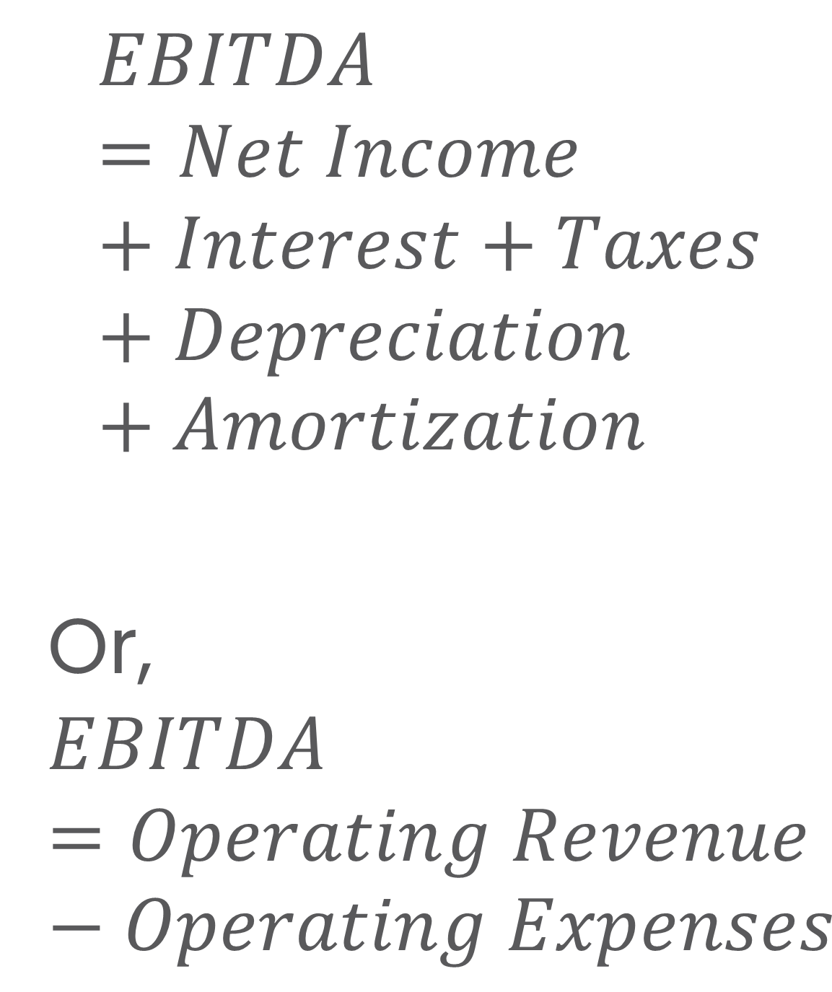
Understanding EBITDA
$$EBITDA=Net Income+Interest+Taxes+Depreciation+Amortization$$
Or,
$$EBITDA=Operating Revenue −Operating Expenses$$
Item | Amount
Revenue | $1,000,000
Cost of Goods Sold | (400,000)
Operating Expenses (e.g., salaries, marketing) | (300,000)
Depreciation | (50,000)
Interest | (20,000)
Taxes | (30,000)
Net Income | $200,000
$$EBITDA=200,000+20,000+30,000+50,000$$
$$=\$300,000$$
EBITDA measures a firm’s operating performance before financing and tax costs.

Slide 46
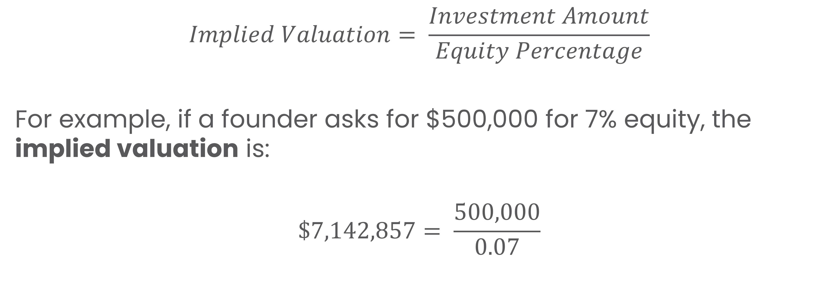
Understanding the VC Method
$$Implied Valuation= \frac{Investment Amount}{Equity Percentage}$$
For example, if a founder asks for $500,000 for 7% equity, the implied valuation is:
$$\$7,142,857= \frac{500,000}{0.07}$$

Slide 47
Drivers of Value
Revenue growth – size and speed of sales expansion
Profitability and margins – efficiency and pricing power
Customer base – size, loyalty, and repeat sales
Assets and intellectual property – tangible and intangible resources
Management and systems – the team’s ability to sustain growth
Market risk – competition, regulation, and volatility

Slide 48
For Agribusiness and Food Ventures
Often a blend of asset-based (land, facilities) and income-based (sales, contracts) valuation.
Intangibles like brand reputation, customer loyalty, supply relationships, and certifications (e.g., organic) can add significant value.

Slide 49
Quiz!

Slide 50
Summary
Describe how agribusiness ventures move from growth to scaling and why planning becomes more important as they expand.
Use a SWOT analysis to identify what a business does well, where it struggles, and where new opportunities or risks exist.
Explain what scaling means and how to estimate market potential using TAM, SAM, and SOM.
Find and interpret real market data (for example, from IBISWorld) to understand a venture’s growth potential.
Explain how a business’s value is determined and why valuation matters for entrepreneurs and investors.
Calculate simple valuation examples and understand what EBITDA shows about a company’s financial performance.
Identify the main factors that drive value in agribusiness and food ventures, such as brand, customers, and profitability.

Slide 51
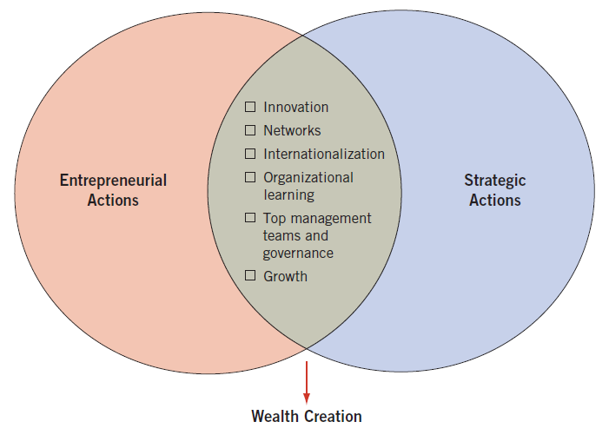
Integration of Entrepreneurial and Strategic Actions
Strategic thinking synthesizes the intuition and creativity of an entrepreneur into a vision for the future.
Source: R. Duane Ireland, Michael A. Hitt, S. Michael Camp, and Donald L. Sexton, “Integrating Entrepreneurship and Strategic Management Actions to Create Firm Wealth,” Academy of Management Executive 15, no. 1 (February 2001): 51.

Slide 52
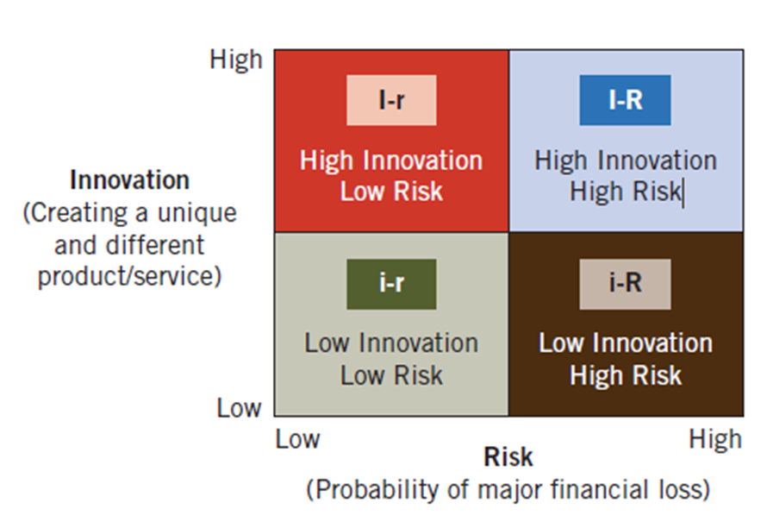
An Entrepreneurial Strategy Matrix Model
Measures risk and innovation
Risk: probability of major financial loss, with R as high risk and r as low risk
Innovation: creation of something new and different, with I as high innovation and i as low innovation
Can develop strategies within cell to reduce risk and increase innovation.
Source: Matthew C. Sonfield and Robert N. Lussier, “The Entrepreneurial Strategic Matrix: A Model for New and Ongoing Ventures.” Reprinted with permission from Business Horizons, May/June 1997, by the trustees at Indiana University, Kelley School of Business.

Slide 53
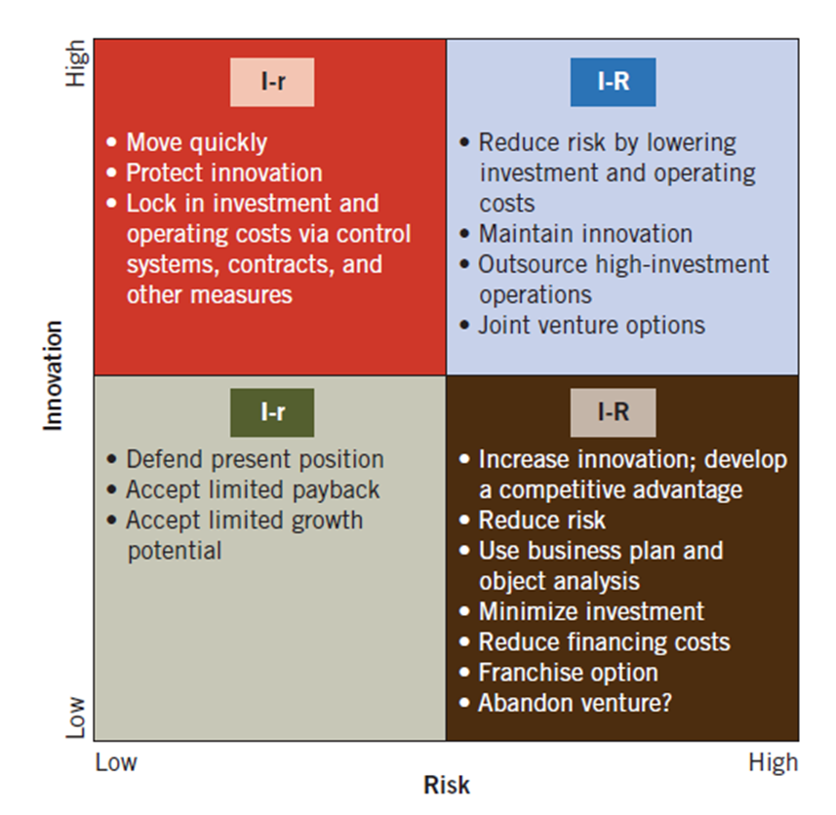
An Entrepreneurial Strategy Matrix Model
Measures risk and innovation
Risk: probability of major financial loss, with R as high risk and r as low risk
Innovation: creation of something new and different, with I as high innovation and i as low innovation
Can develop strategies within cell to reduce risk and increase innovation.
Source: Matthew C. Sonfield and Robert N. Lussier, “The Entrepreneurial Strategic Matrix: A Model for New and Ongoing Ventures.” Reprinted with permission from Business Horizons, May/June 1997, by the trustees at Indiana University, Kelley School of Business.

